Slide 1
Video Conferencing Application
Presentation By:-
Dhairya Kumar Sharma (500067932)
Muskan Sawa (500067886)
Under The Guidance Of :-
Dr. Ravi Tomar [Assistant Professor(SG)]

Slide 2
Introduction
Video conferencing and online meetings have become a norm after 2020. Most of us prefer being at home and complete our projects while still being efficient in terms of work flow or just chat with our friends as if they were in front of us.
Web apps like zoom , Meet , Teams got a major boost due to this .There are a lot of useful services they offer us like video and screen sharing, file sharing etc, some of the services are premium and generate a lot of revenue .
WebRTC is the go to tool when it comes to real time audio/video transfer that most of these companies use.
AIM: Our aim is to study the WebRTC architecture and implement its features to create an open source video conferencing platform.

Slide 3
Objective
Facilitate Realtime audio/video communication on the web using a peer-to-peer protocol for creating an experience like augmented reality for better collaborative experience.
Create a real time meeting room and share the invite over mail.
Add call recording feature

Slide 4
Methodology
Create an RTCPeerConnection
Call getUserMedia() to access webcam and microphone
Add local stream by calling RTCPeerConnection.addStream()
Create an SDP offer by calling RTCPeerConnection.createOffer()
Set description of User A’s end of the call by calling RTCPeerConnection.setLocalDescription()
Send the offer through the signalling server to User B in a message type “video-offer”
Create an RTCSessionDescription using received SDP answer
Pass the session description to RTCPeerConnection.setRemoteDescription() to configure User A’s WebRTC layer to know how User B’s end of connection is configured

Slide 5
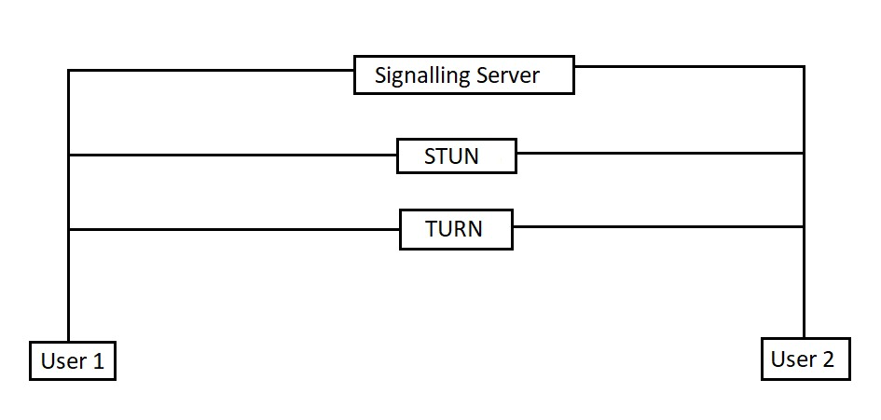

Slide 6
UDP vs TCP
TCP is a connection-oriented protocol, whereas UDP is a connectionless protocol.
TCP ensures retransmission of lost packets is possible, whereas UDP doesn’t perform retransmission.
UDP is much faster than TCP and also supports broadcasting while TCP doesn’t.
TCP reads data as byte stream and messages are transmitted to segment boundaries while UDP packets with defined boundaries which are sent individually and checked for integrity upon arrival.
TCP performs extensive error checking and acknowledgment of data while UDP only performs basic error checking
In our project, UDP handles video conferencing while the rest of the communication is performed using TCP.

Slide 7
Issues with Existing Real-Time Communication Solutions
Until recently, real-time communication services were impeded by development and distribution challenges that were prohibitive to innovation. For example, developers fluent in proprietary communication technologies (think VoIP) could be hard to find, and thus expensive. Furthermore, once an application was developed, getting it in the hands of the end-user required them to download and install software or plugins, hindering distribution.
WebRTC could revolutionize, for example, the way a small e-commerce website owner communicates with her online shoppers, or the way members of a web community like Reddit or Quora interact with one another.

Slide 8
WebRTC
WebRTC (Web Real-Time Communication) is a free and open-source project providing web browsers and mobile applications with real-time communication via application programming interfaces . It allows audio and video communication to work inside web pages by allowing direct peer-to-peer communication, eliminating the need to install plugins or download native apps.
A WebRTC application will usually go through a common application flow. Accessing the media devices, opening peer connections, discovering peers, and start streaming.

Slide 9
Main use cases for WebRTC:
Unified communications – voice and video calling, 1:1 or group sessions
Contact centre communications – client/agent, visual assistance, remote assistance, etc
Watch parties – watch television or a sports event together
eCommerce and retail – from one-to-one high touch sales to live broadcast for sales events and promotions
Telehealth, online education, legal proceedings, remote travel, fitness, dancing, tutoring, coaching, … – conduct remotely and virtually verticalized sessions you would have done in-person in the past
Teleoperations – drive cars, forklifts, trucks, drones, boats, submarines, … – remotely
Virtual and hybrid events – conduct webinars, large meetings and events online
Low latency broadcasting – broadcast a sports game, auction or interactive sessions to a large audience at sub second latency
Cloud gaming – render the visuals of a game in the cloud and send it in Realtime to the player
Machine remoting – operate a remote machine (high performance machines or highly secured/configured machines) as if it was a local one
Virtual spaces and the metaverse – meet people in a synthetically rendered virtual environment in 2D or 3D

Slide 10
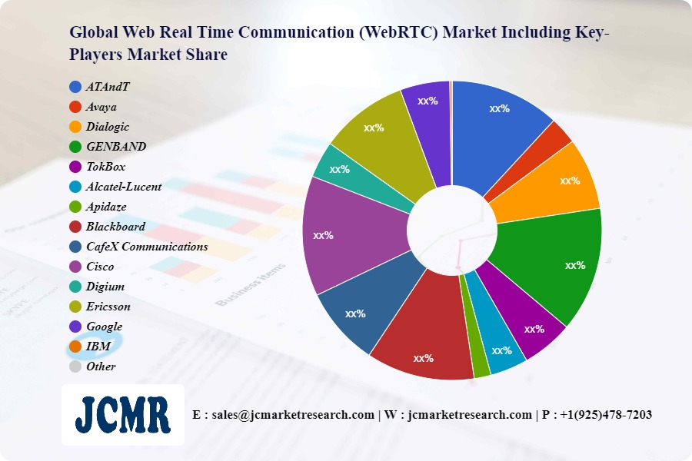

Slide 11
NAT
Network Address Translation-Traversal (NAT-T) is a method for getting around IP address translation issues encountered when data protected by IPsec passes through a NAT device for address translation. Any changes to the IP addressing, which is the function of NAT, causes IKE to discard packets. After detecting one or more NAT devices along the Datapath during Phase 1 exchanges, NAT-T adds a layer of User Datagram Protocol (UDP) encapsulation to IPsec packets so they are not discarded after address translation. NAT-T encapsulates both IKE and ESP traffic within UDP with port 4500 used as both the source and destination port. Because NAT devices age out stale UDP translations, keepalive messages are required between the peers.

Slide 12
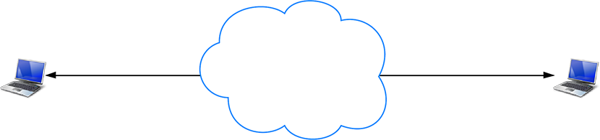
How it would look like without NAT

Slide 13
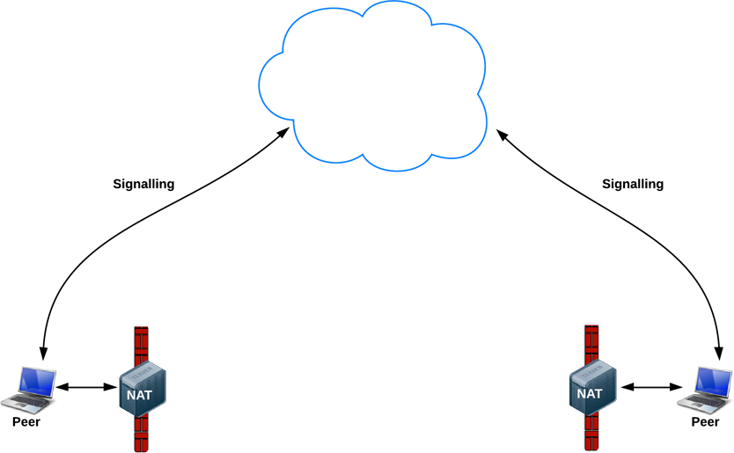
Signalling
WebRTC enables peer-to-peer communication, but it still needs servers so that clients can exchange metadata to coordinate communication through a process called signalling, and to cope with network address translators (NATs) and firewalls.

Slide 14
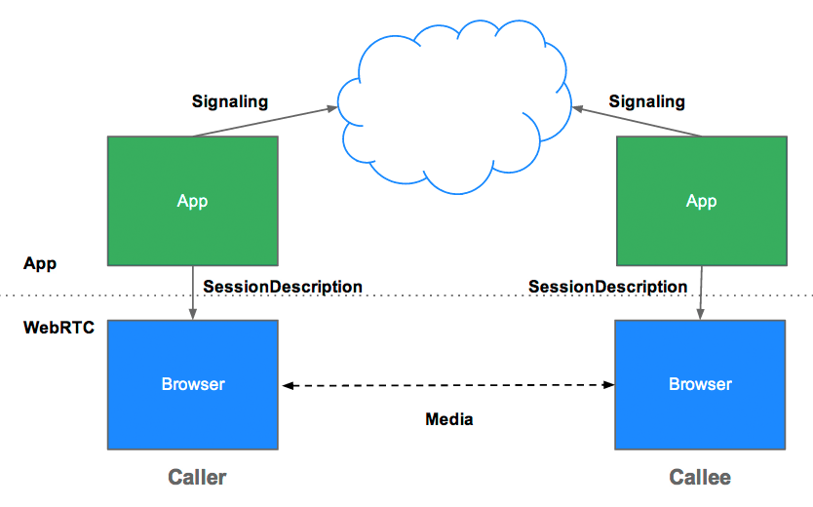
Signalling is the process of coordinating communication. In order for a WebRTC app to set up a call, its clients need to exchange the following information:
Session-control messages used to open or close communication
Error messages
Media metadata, such as codecs, codec settings, bandwidth, and media types
Key data used to establish secure connections
Network data, such as a host's IP address and port as seen by the outside world

Slide 15
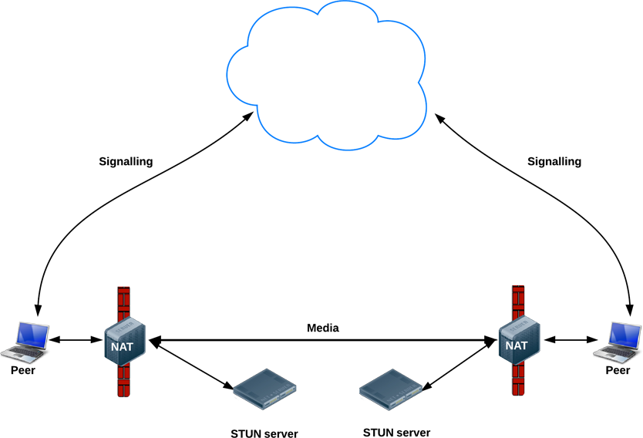
STUN
STUN is a tool used by other protocols, such as Interactive Connectivity Establishment (ICE), the Session Initiation Protocol (SIP), and WebRTC. It provides a tool for hosts to discover the presence of a network address translator, and to discover the mapped, usually public, Internet Protocol (IP) address and port number that the NAT has allocated for the application's User Datagram Protocol (UDP) flows to remote hosts. The protocol requires assistance from a third-party network server (STUN server) located on the opposing (public) side of the NAT, usually the public Internet.

Slide 16
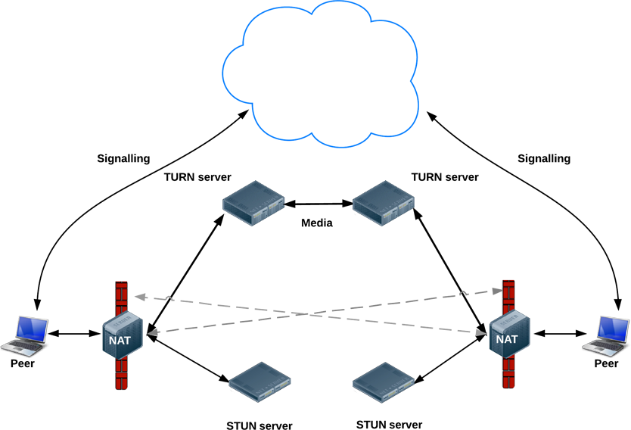
TURN
RTCPeerConnection tries to set up direct communication between peers over UDP. If that fails, RTCPeerConnection resorts to TCP. If that fails, TURN servers can be used as a fallback, relaying data between endpoints.

Slide 17
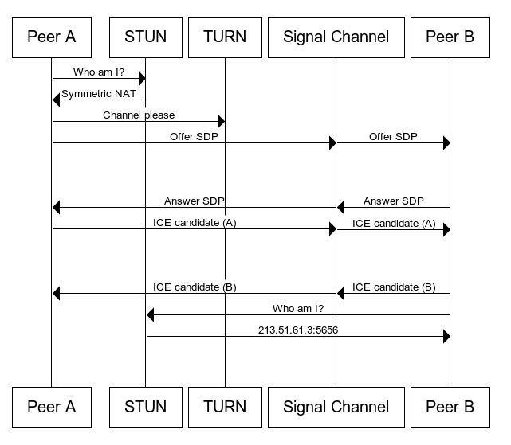
overview

Slide 18
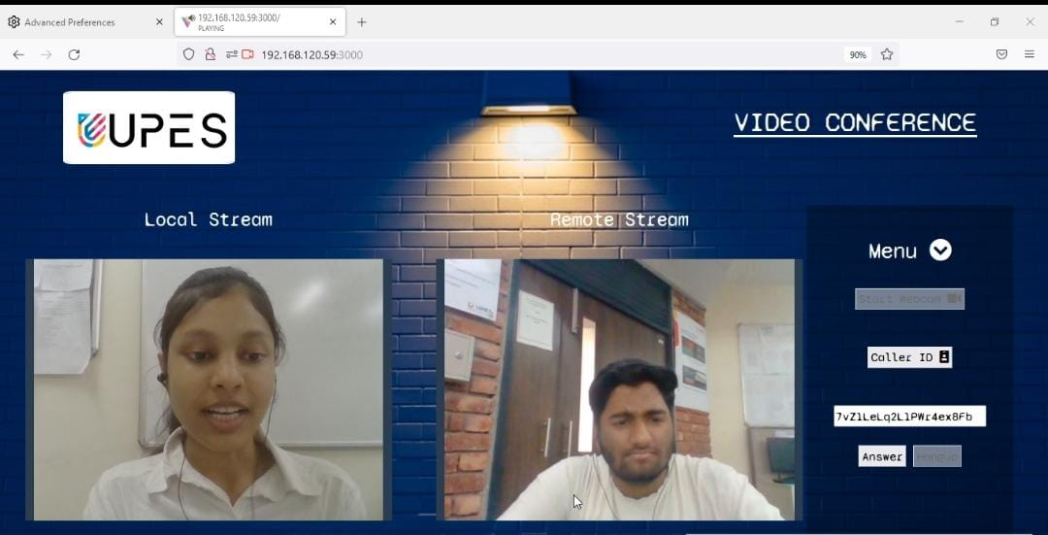
Progress up till now

Slide 19
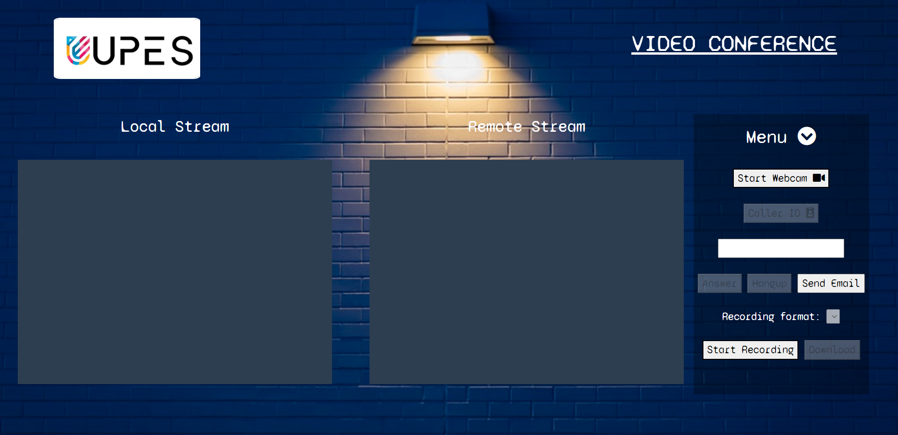

Slide 20
SWOT ANALYSIS
STRENGTH : Open source code
WEAKNESS: Still under development
OPPORTUNITIES: small e-commerce website owner communicates with her online shoppers, or the way members of a web community like Reddit or Quora interact with one another.
THREATS:
Extract password using phishing techniques
Send malicious code embedded within a text message to the victim
Capture conversation data.
Capture information about user during signalling phase

Slide 21
Areas of improvement
To grow the meeting size (adding up to 1000 users will need a new architecture)
Add file sharing feature in real time
Additional tools like voice cancellation + video blur
Improved user privacy and application security
Make our own signalling server using XMPP server Ex: ejjaberd.

Slide 22
The Future of WebRTC
It isn’t difficult to imagine a world in which you click on a “Contact Us” link on a website and are then greeted with a representative on video asking how they can help out. Imagine that a user was performing their online banking and runs into an issue; with WebRTC, they could share their screen with one of the bank’s support agents and be walked-through in real-time towards a solution to their issue.

